Slide 1


DETECTION AND CLASSIFICATION OF FAKE JOB RECRUITMENT POSTING
By Team : DELTA
Varun Biren Majithia : 200532798
Samarth Subhash Deshpande : 200532782
Jannatul Ferdousi Rajoni : 200530077
INSTRUCTOR: DR TIMOTHY OLESKIW
Date : 8/04/2025
1
Notes:
"Good morning, everyone! I’m Jannatul Ferdousi Rajoni, and I’m excited to present our project on the
'Detection and Classification of Fake Job Recruitment Postings.' I’m joined by my talented team, Delta,
consisting of Varun Biren Majithia, Samarth Subhash Deshpande, and Jannatul Ferdousi Rajoni. We’ve
been working under the guidance of Dr. Timothy Oleskiw, and today,we’re thrilled to share our findings
with you.
Before diving into the details, let’s take a moment to understand why this project matters. [Pause] Every
day, job seekers face the risk of falling victim to online scams—losing money, time, and even personal
data. Our goal? To build a tool that helps users distinguish real opportunities from fraudulent ones.
Let’s explore how we tackled this challenge."

Slide 2



PROJECT GOAL
Current Situation
Our Project Goal
Rise in online job scams targeting job seekers.
Victims suffer financial losses and identity theft.
Need AI Tool to detect the Job Scam
Build a Streamlit web app to classify job postings as:
Fraudulent or Legitimate
Provide a scam severity score for the prediction.
Integrate LIME to explain:
Which features influenced the prediction?
Help users trust and understand the model’s decisions.
2
Notes:
"The rise of online job scams is alarming. Victims don’t just lose money—they risk identity theft and
emotional distress. For example, a fake job posting might ask for ‘training fees’ or sensitive information
like Social Security numbers.
To combat this, we set two key objectives:
Build a Streamlit web app that classifies job postings as fraudulent or legitimate, complete with a
probability score.
Integrate LIME(Local Interpretable Model-agnostic Explanations.), an explainability tool, to show which
features influenced the prediction—like suspicious wording or missing company details.
Why LIME? Transparency builds trust. Users deserve to know why a job posting was flagged, not just the
result.
This leads us to our approach…"

Slide 3






EXECUTIVE SUMMARY
Data Cleaning
ML pipeline for detecting fake job posts (text + structured data)
Feature Selection
Preprocessing: lemmatization, gibberish removal, TF-IDF
Models: LR, RF, NB, XGBoost, DistilBERT
Feature selection: MI, Chi-Square, SelectKBest
Model Training
LIME: explains key features behind prediction
Streamlit app: predicts and shows probability
Web Application
3
Notes:
"Our solution is a machine learning pipeline that processes both text and structured data from job
postings. Here’s the high-level workflow:
First, preprocessing: We cleaned text by removing gibberish, expanding contractions (like converting I’m
to I am), and applying lemmatization to reduce words to their root forms.
Next, model training: We tested multiple algorithms—Logistic Regression, Random Forest, even
BERT—to find the best performer.
Finally, deployment: We packaged this into a user-friendly Streamlit app.
But the heart of any ML project? Data quality. Let’s look at how we prepared our dataset…"

Slide 4





APPROACH
Data Collection & Preprocessing
Feature Extraction & Selection
Model Training & Deployment
Dataset: Collected job posting data (text + structured data) from kaggle.
🧹 Text Preprocessing:
Lowercasing
HTML tag removal
Contraction expansion (e.g., "I'm" to "I am")
Gibberish removal
Lemmatization & stopword removal
🔍 Text Features: Extracted features using TF-IDF (up to 5000 words per column).
📊 Feature Selection:
Mutual Information (MI) for numeric/categorical features
Chi-Square for categorical features
SelectKBest for Random Forest
🧠 Models Used:
Logistic Regression (LR)
Random Forest (RF)
Naive Bayes (NB)
XGBoost
DistilBERT
Deployment & Explainability
🖥️ Streamlit App: Deployed a web app to classify job posts & show prediction probability.
🔍 LIME: Added for explainability to show which features influenced predictions.
4
Notes:
"We sourced our dataset from Kaggle, which included job titles, company profiles, and descriptions. The
Raw data is very messy.
"Now, let’s dive into how we transformed messy job postings into clean, model-ready text. Think of this
like washing and chopping ingredients before cooking—essential for a great dish!
Lowercasing:
First, we standardized everything to lowercase. Why? Because ‘Data Scientist’ and ‘data scientist’ are the
same job—just capitalized differently. Lowercasing ensures the model treats them as identical.
HTML Tag Removal:
Many job posts are scraped from websites, so they’re full of hidden HTML tags like <div> or <b>. We
stripped these out—because a tag like <p> tells us nothing about whether the job is real or fake.
Contraction Expansion:
We expanded contractions like “you’ll” to “you will” and “I’m” to “I am.” This helps the model see the
full meaning of phrases instead of getting distracted by shorthand.
Gibberish Removal:
Fake posts often include random text like ‘$$$’ or ‘ASAP123’ to grab attention. We filtered these
out—because gibberish is a red flag for scams, but it’s useless for training.
Lemmatization & Stopwords:
Finally, we boiled words down to their root forms (lemmatization), so ‘running’ and ‘ran’ both become
‘run.’ We also removed filler words (stopwords) like ‘the’ or ‘and’—they add noise without meaning.
The result? A clean, structured dataset where the model can focus on what actually matters—like
suspicious wording or missing company details—instead of getting lost in the noise."**
(Pause, then transition to the next topic:)
"But cleaning text alone isn’t enough. To detect scams, we also needed to extract meaningful
features—which brings us to TF-IDF and BERT…"
"TF-IDF assigns weights based on two factors: term frequency (TF) — how often a word appears in a
document — and inverse document frequency (IDF) — how rare it is across all posts. This ensures words
like 'Python' get high weights if they're frequent in one job but uncommon overall, while generic terms
like 'team' get low weights. We capped it at 5,000 words to focus computational power on the most
meaningful signals."
"Think of it like highlighting unique ingredients in a recipe — common ones like 'salt' get ignored, but
rare spices like 'saffron' stand out."
But not all features are created equal. We used:
Mutual Information for numeric data.
Chi-Square tests for categorical data.
SelectKBest for Random Forest
This rigorous process ensured our models trained on meaningful patterns, not noise. Speaking of
models…"

Slide 5


MODEL DESCRIPTION
Model Description Overview
Objective: Detect fake job posts using machine learning techniques.
Data Source: Kaggle dataset containing job posts with features such as job titles, company profiles, descriptions, and other categorical/text-based features.
Target Variable: "Fraudulent" – Identifying fake job postings (1) vs. real job postings (0).
Model Type: Supervised classification model using text and tabular data.
Class Imbalance: Data is imbalanced with fewer fraudulent job posts.
5
Notes:
"Our target variable was straightforward: a binary flag marking posts as fraudulent (1) or legitimate (0).
But we faced a major hurdle: class imbalance.
In the original dataset, only 5% of posts were fraudulent. [Pause] That’s like finding 20 needles in a
haystack of 400 pieces of straw! To fix this, we undersampled the majority class, creating a balanced
dataset for training.
We also dropped sparse columns like salary_range and location that added little value.
Now, you might wonder—which model performed best? That’s where things get interesting…"

Slide 6
WHAT MAKES OUR PROJECT STAND OUT?
Beyond Basic Detection: Hybrid Models + Explainability + Real-World Deployment
Hybrid Data Approach
Others: Only analyze job descriptions (text)
We combined: Text + Structured Data (company profiles,Company Logo)
Result: Captured more scam patterns (e.g., fake companies)
5-Model Shootout
Others: Test 1-2 models (usually BERT or Logistic Regression)
We compared: LR, Random Forest, Naive Bayes, XGBoost + GloVe, DistilBERT
Result: Proved simpler models (Random Forest) work better than BERT here
Explainability Built-In
Others: Just give "fraud/not fraud" results
We added: LIME explanations, Scam Severity Score
Result: Users can trust and understand decisions
6

Slide 7
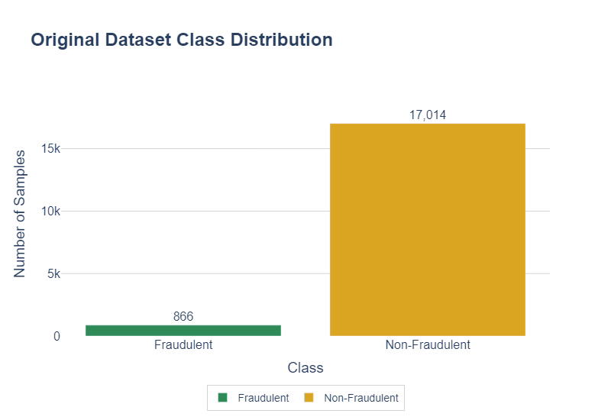

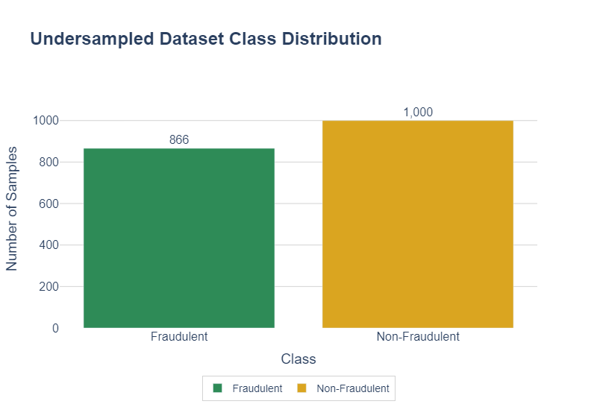

MODEL DESCRIPTION
Data Preprocessing & Class Balancing
Data Preprocessing
Missing Value Handling
Dropped rows with >30% missing data where fraudulent = 0
Filled:
Text columns → 'Missing'
Categorical columns → 'Unknown', 'Not Specified'
Dropped sparse columns: department, salary_range, location, job_id
Class Balancing
Original data was heavily imbalanced
Applied undersampling:
7

Slide 8

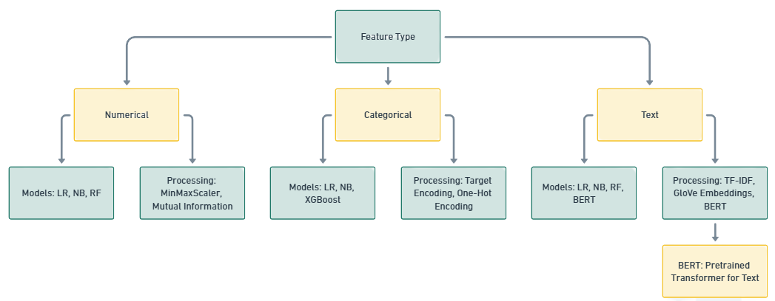


MODEL DESCRIPTION
Feature Engineering & Selection
Numerical Features
Scaled with MinMaxScaler
Feature selection:
Mutual Information (LR, NB)
SelectKBest (RF)
Categorical Features
Encoding:
Target Encoding (LR, NB, XGBoost)
One-Hot Encoding (Random Forest)
Feature selection:
Chi-Square (NB), MI (LR), SelectKBest (RF)
Text Features
Preprocessed (already covered in earlier slide)
Vectorized using:
TF-IDF (Logistic Regression, NB, RF)
GloVe Embeddings (XGBoost)
DistilBERT
Full Form
LR - Linear Regression
NB - Naive Bayes
RF - Random Forest
8
Notes:
1. Mutual Information (MI) tells us how much knowing a feature helps us predict if a job posting is fraudulent. The Mutual Information (MI) score is a measure from information theory that quantifies the amount of information obtained about one feature by observing the other feature. If a feature has a high MI score with the target (fraud or not fraud), it means the feature is useful for making that prediction. In simple terms, if knowing X changes your belief about Y, then MI is greater than zero. MI helps us capture all types of relationships, not just linear ones, which is important because real-world data is messy.
2. Chi-Square is a statistical test used with categorical features, especially for models like Naive Bayes. For example, let’s say you have a feature like job_type (full-time, part-time, contract). Chi-Square checks if the distribution of fraud vs. legit jobs is significantly different for each job type. If the distribution is very different from what we'd expect by chance, then job type is an important feature for predicting fraud.
3. ANOVA with SelectKBest is used in Random Forest. It compares the variance between classes (fraud vs. legit) to the variance within classes. If a feature has very different means for fraud vs. legit jobs, it’s considered a strong predictor. The greater the difference between the groups, the more important the feature is for prediction.

Slide 9
MODEL DESCRIPTION :
Model Training Process
Steps | Details
1. Data Splitting | 🧑‍💻 Training: 80%, 🧪 Test: 20%🔄 Stratified: Maintains class balance
2. Model Selection | ⚖️ Logistic Regression: Baseline🌲 Random Forest: Ensemble 📈 Gradient Boosting: High accuracy🔢 Naive Bayes: Text classification 🤖 BERT: Deep learning for NLP tasks🔄 XGBoost: High performance for structured/tabular data
3. Cross-Validation | 🔁 K-Fold: Train/test K times🔄 Stratified K-Fold: Class balance
4. Bert Model Architecture | 🤖 DistilBERT: Fine-tuned for fake job detection🔄 Bidirectional: Left-right & right-left
Hyperparameters (Bert) | ⚙️ LR: 2e-5, 🎛️ Batch Size: 16, 🔁 Epochs: 3, 📏 Max Length: 256 tokens
5. Hyperparameter Tuning | 🔍 Grid Search: Exhaustive🎯 Random Search: Efficient
6. Training Process | 🧑‍🏫 Train: 80%, ✅ Test: 20%🌲 Random Forest: Trees, depth📊 Gradient Boosting: LR, estim
9
Notes:
Logistic Regression is an efficient, interpretable model for binary classification, estimating probabilities with clear decision boundaries. Random Forest, an ensemble method, builds multiple decision trees, effectively handling various data distributions and capturing non-linear relationships, while providing feature importance insights. Naive Bayes, based on independent features, excels in text classification tasks like spam filtering due to its speed and scalability, applying Bayes' Theorem to predict class probabilities.
GloVe (Global Vectors for Word Representation) is a pre-trained word embedding model that captures word meanings through global co-occurrence statistics from a vast corpus. It translates text into semantic vectors, improving the XGBoost model's ability to differentiate between legitimate and fraudulent job postings by clustering related words.
XGBoost, a gradient boosting algorithm, combines weak learners to create accurate models, particularly effective for imbalanced datasets like fraudulent job postings. It captures complex patterns, incorporates regularization to prevent overfitting, and sequentially trains models to correct previous errors, making it powerful for various machine learning tasks.

Slide 10
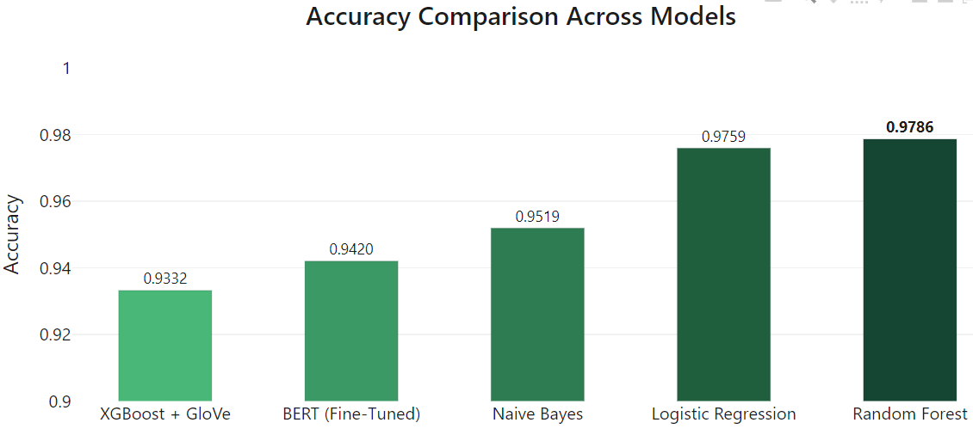
MODEL DESCRIPTION
Model Evaluation - Accuracy
Logistic Regression and Random Forest exhibit the highest accuracy (0.9759 and 0.9786), showing strong generalization across job post types.
10
Notes:
Narrative:
“We’ve trained five models—using techniques like stratified splits and hyperparameter tuning. Now, how do we pick the best one for real-world fraud detection? Let’s analyze their performance across five critical metrics.”
Q&A Integration:
Question (Self-posed): “Why not just pick the model with the highest accuracy?”
“Because accuracy alone is like judging a book by its cover. A model might be right 97% of the time but still fail
Observation:
All models exceed 93% accuracy, suggesting the task isn’t overly complex. Random Forest leads (0.9786), but Logistic Regression (0.9759) keeps up.
Deep Dive:
Why isn’t BERT on top?
Transformers like BERT excel in deep context tasks (e.g., sentiment analysis), but fake job detection may rely on simpler keyword patterns.
Q&A: “Why would a simpler model compete with BERT?”
“BERT’s strength in understanding context isn’t fully leveraged here. Fraudulent job posts often use obvious red flags like ‘urgent hiring’ or mismatched titles—patterns even basic models catch.”
XGBoost + GloVe’s lower accuracy (0.9332) vs. higher CV score (0.9664) hints at overfitting:
Q&A: “How did overfitting happen here?”
“GloVe’s pre-trained embeddings might include irrelevant general language features, causing the model to ‘memorize’ noise instead of job-specific fraud signals.”
Real-World Link:
“In spam detection, 97% accuracy is great, but we’d sacrifice it for higher precision to avoid blocking legitimate emails.”
Transition:
“But accuracy alone doesn’t tell the whole story. Let’s dig into precision.”

Slide 11
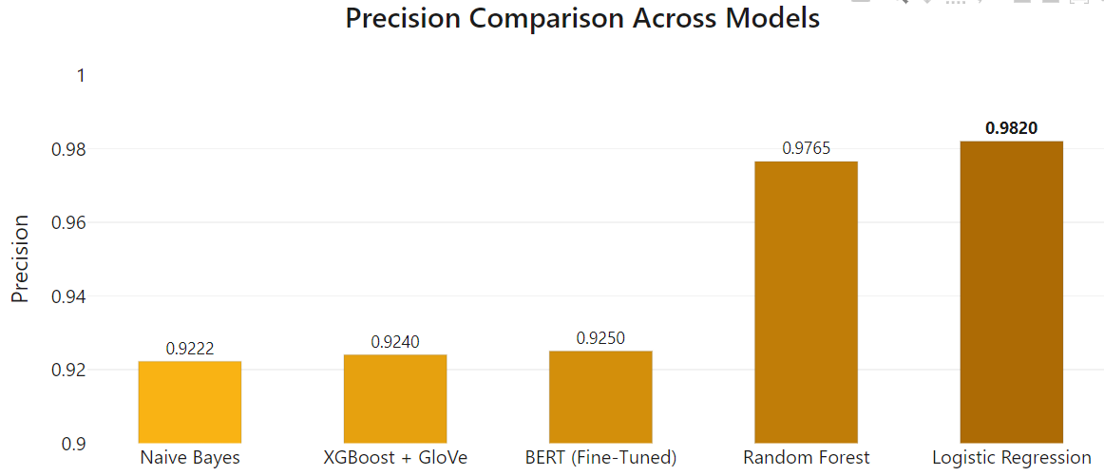
MODEL DESCRIPTION
Model Evaluation - Precision
Logistic Regression maintains the highest precision (0.9820), closely followed by Random Forest (0.9765), meaning these models excel in identifying true fraudulent job posts while avoiding false positives.
11
Notes:
Slide 2 – Precision
“Logistic Regression has highest precision (0.9820), missing fewer false alarms!”
Observation:
High precision = fewer false positives. Crucial for fraud detection to avoid mistrusting legitimate companies.
Deep Dive:
Naive Bayes’ low precision (0.9222):
Q&A: “Why does Naive Bayes struggle here?”
“Its assumption that features (e.g., job title, description) are independent which is unrealistic. Phrases like ‘no experience needed’ and ‘wire transfer’ together signal fraud—but Naive Bayes treats them in isolation.”
Random Forest (0.9765) balances precision and recall, while BERT’s moderate precision (0.9250) suggests it struggles with class imbalance.
Q&A: “Why does BERT flatter with class imbalance?”
“Transformers thrive on large, balanced datasets. Our undersampled data with around 866 fraud class and 1000 non fraud likely starved BERT of complex fraud patterns.”
Real-World Link:
“Think of precision as a fire alarm: Too many false alarms, and people stop trusting it.”
Transition:
“But what if missing a fraudulent post is worse? Enter recall.”

Slide 12
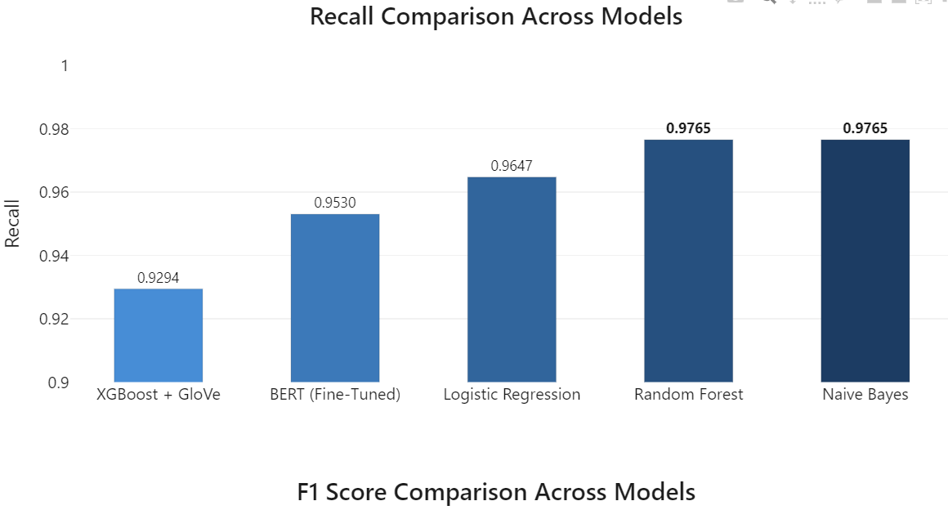
MODEL DESCRIPTION
Model Evaluation - Recall
Naive Bayes and Random Forest performs best in recall (0.9765), meaning it does a better job at capturing all the fraudulent job posts compared to other models.
12
Notes:
“Naive Bayes catches almost all frauds (0.9765 recall)—but at what cost?”
Observation:
High recall = minimal missed frauds. Critical in medical diagnostics but risky here if it overwhelms users with false alerts.
Deep Dive:
Naive Bayes’ high recall:
Q&A: “Why is Naive Bayes so sensitive?”
“It treats every suspicious word as a standalone red flag. For example, ‘flexible hours’—common in both scams and gig jobs—triggers a fraud alert too easily.”
BERT’s recall (0.9530):
Q&A: “Why doesn’t BERT achieve perfect recall?”
“BERT needs context to connect subtle clues. Without enough data, it misses scams that use cleverly disguised language.”
Real-World Link:
“Imagine a COVID test with high recall: It catches all cases but quarantines healthy people. Trade-offs matter!”
Transition:
“To balance precision and recall, we need the F1 score.”

Slide 13
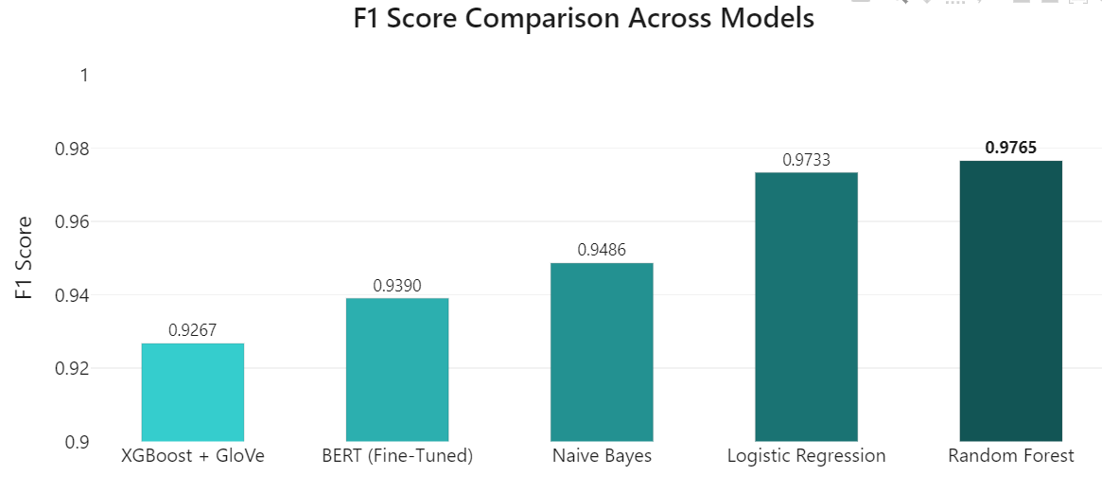
MODEL DESCRIPTION
Model Evaluation - F1 Score
Logistic Regression and Random Forest have the highest F1 scores (0.9733 and 0.9765), indicating good balance between precision and recall for these models.
13
Notes:
“Random Forest wins the F1 battle (0.9765)—but why doesn’t BERT dominate?”
Observation:
F1 balances precision and recall. Random Forest’s strength comes from ensemble learning, combining multiple decision trees.
Deep Dive:
Logistic Regression’s strong F1 (0.9733):
Q&A: “How does Logistic Regression stay competitive?”
“Its simplicity forces it to focus on the strongest fraud indicators, like company profiles, requirements avoiding distractions from noisy features.”
XGBoost + GloVe’s lower F1 (0.9267):
Q&A: “Why do embeddings hurt XGBoost here?”
“GloVe’s general word vectors dilute job-specific terms. TF-IDF’s keyword-focused approach (used in logistic regression) works better for this task.”
Transition:
“Finally, which model is most reliable across different datasets? Let’s check CV scores.”

Slide 14
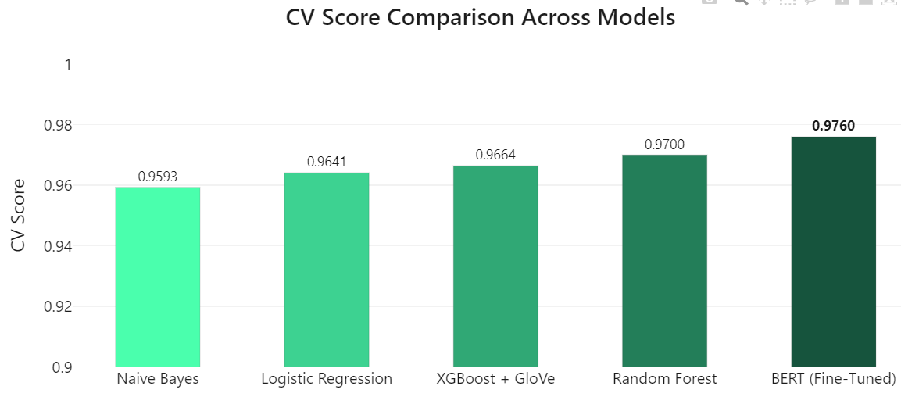
MODEL DESCRIPTION
Model Evaluation - Cross-Validation (CV)
BERT (Fine-Tuned) achieves the highest CV score (0.9760), showcasing its stability and robustness across different data splits.
14
Notes:
Slide 5 – CV Score
“BERT’s CV score (0.9760) crushes others—so why isn’t it our winner?”
Observation:
High CV score = consistent performance across data splits. BERT’s transformers generalize well, but its lower accuracy suggests domain mismatch.
Deep Dive:
XGBoost + GloVe’s CV (0.9664) > accuracy (0.9332):
Q&A: “Does this mean our test data is flawed?”
“Possibly! The test set might lack diverse fraud patterns, making XGBoost’s embeddings seem worse than they are.”
Logistic Regression’s lower CV (0.9641):
Q&A: “Why do simple models generalize less?”
“They’re like strict rulebooks—great for clear patterns but brittle when faced with new scam tactics.”
Real-World Link:
“CV is like a restaurant review: Consistency across diners (data splits) matters more than one glowing review (high accuracy).”
Closing:
“So, which model is best? It depends! Need precision? Pick Logistic Regression. Prioritize consistency? BERT. Real-world AI is about trade-offs, not just leaderboards.”

Slide 15
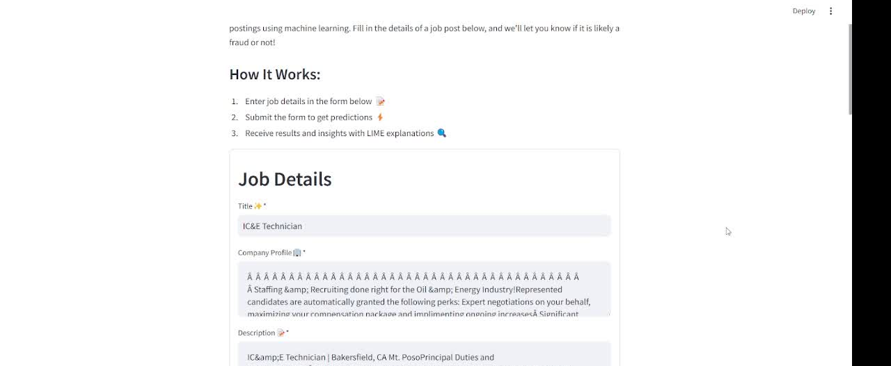
PROJECT DEMONSTRATION USING STREAMLIT WITH BEST MODEL - RANDOM FOREST
15

Slide 16


FUTURE WORK - SMARTER FRAUD DETECTION
1. One-Click Analysis
Accept any input: PDF, URL, or copied text
Auto-extract job details (title, company, description)
2. Instant Fraud Score + Reasons
Show scam probability % (e.g. "87% risky")
Highlight suspicious phrases using LIME (e.g. "❗'No experience needed' + 'high salary'")
3. Streamlit Upgrades
Add batch processing (CSV uploads)
Let users flag errors to improve model
Key Benefit:
"From complex analysis to simple red flags - making fraud detection accessible for every job seeker."
❗'No experience needed'
Scam Score: 92%
16

Slide 17
THANK YOU
ANY QUESTIONS ?
17

